Slide 1
Ellie-SMELLY For AWS-EDU-Kit
UI DeSIGN and DePLOYED BACK-END services screens

Slide 2
HOME TAB
Welcome! EllieSmelly can help identify a smell or you can help us build a collection of smells for other to use as a reference. Tap Start to initiate collection
Start

Slide 3
SELECTION TAB
Great news! I have enough sample for me to try to identify or you to help me learn. Tap to select your preference
Identify
You tell me
Start Over

Slide 4
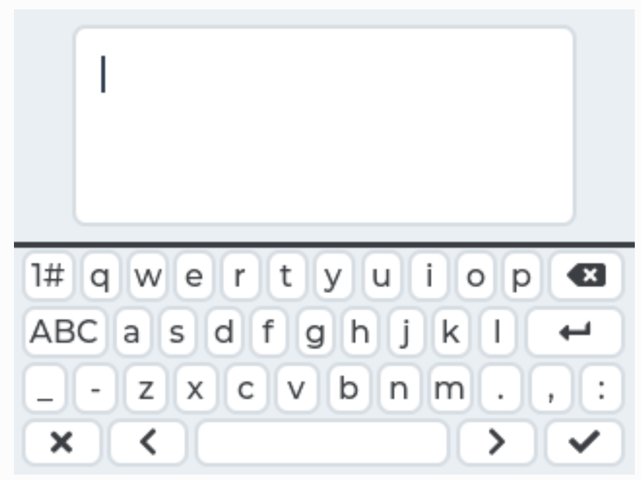
KEYBOARD TAB
Thanks for help me learn, please enter what you think it smells like
Submit
Start Over

Slide 5
SAMPLE_IDENTIFIED TAB
Sample have been identified as : with % confidence
Start Over

Slide 6
SAMPLE_RECEIVED TAB
Sample received! , I have now # of samples of the same kind. The more I have the better matches I can make
Start Over

Slide 7
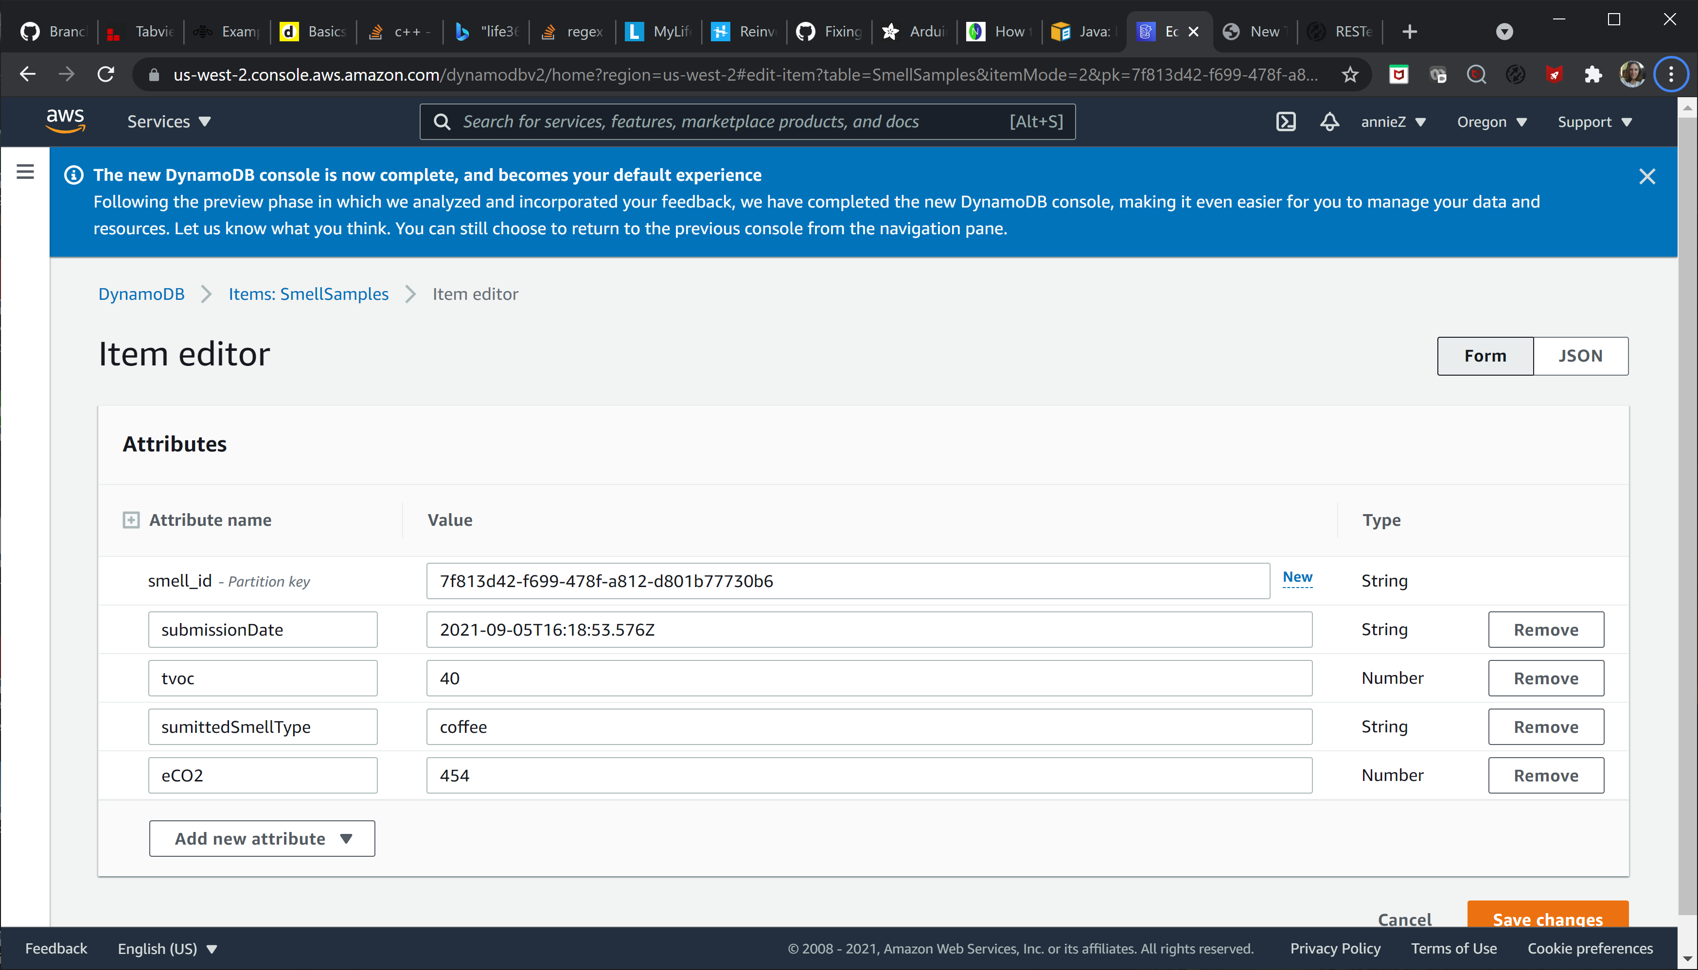

Slide 8
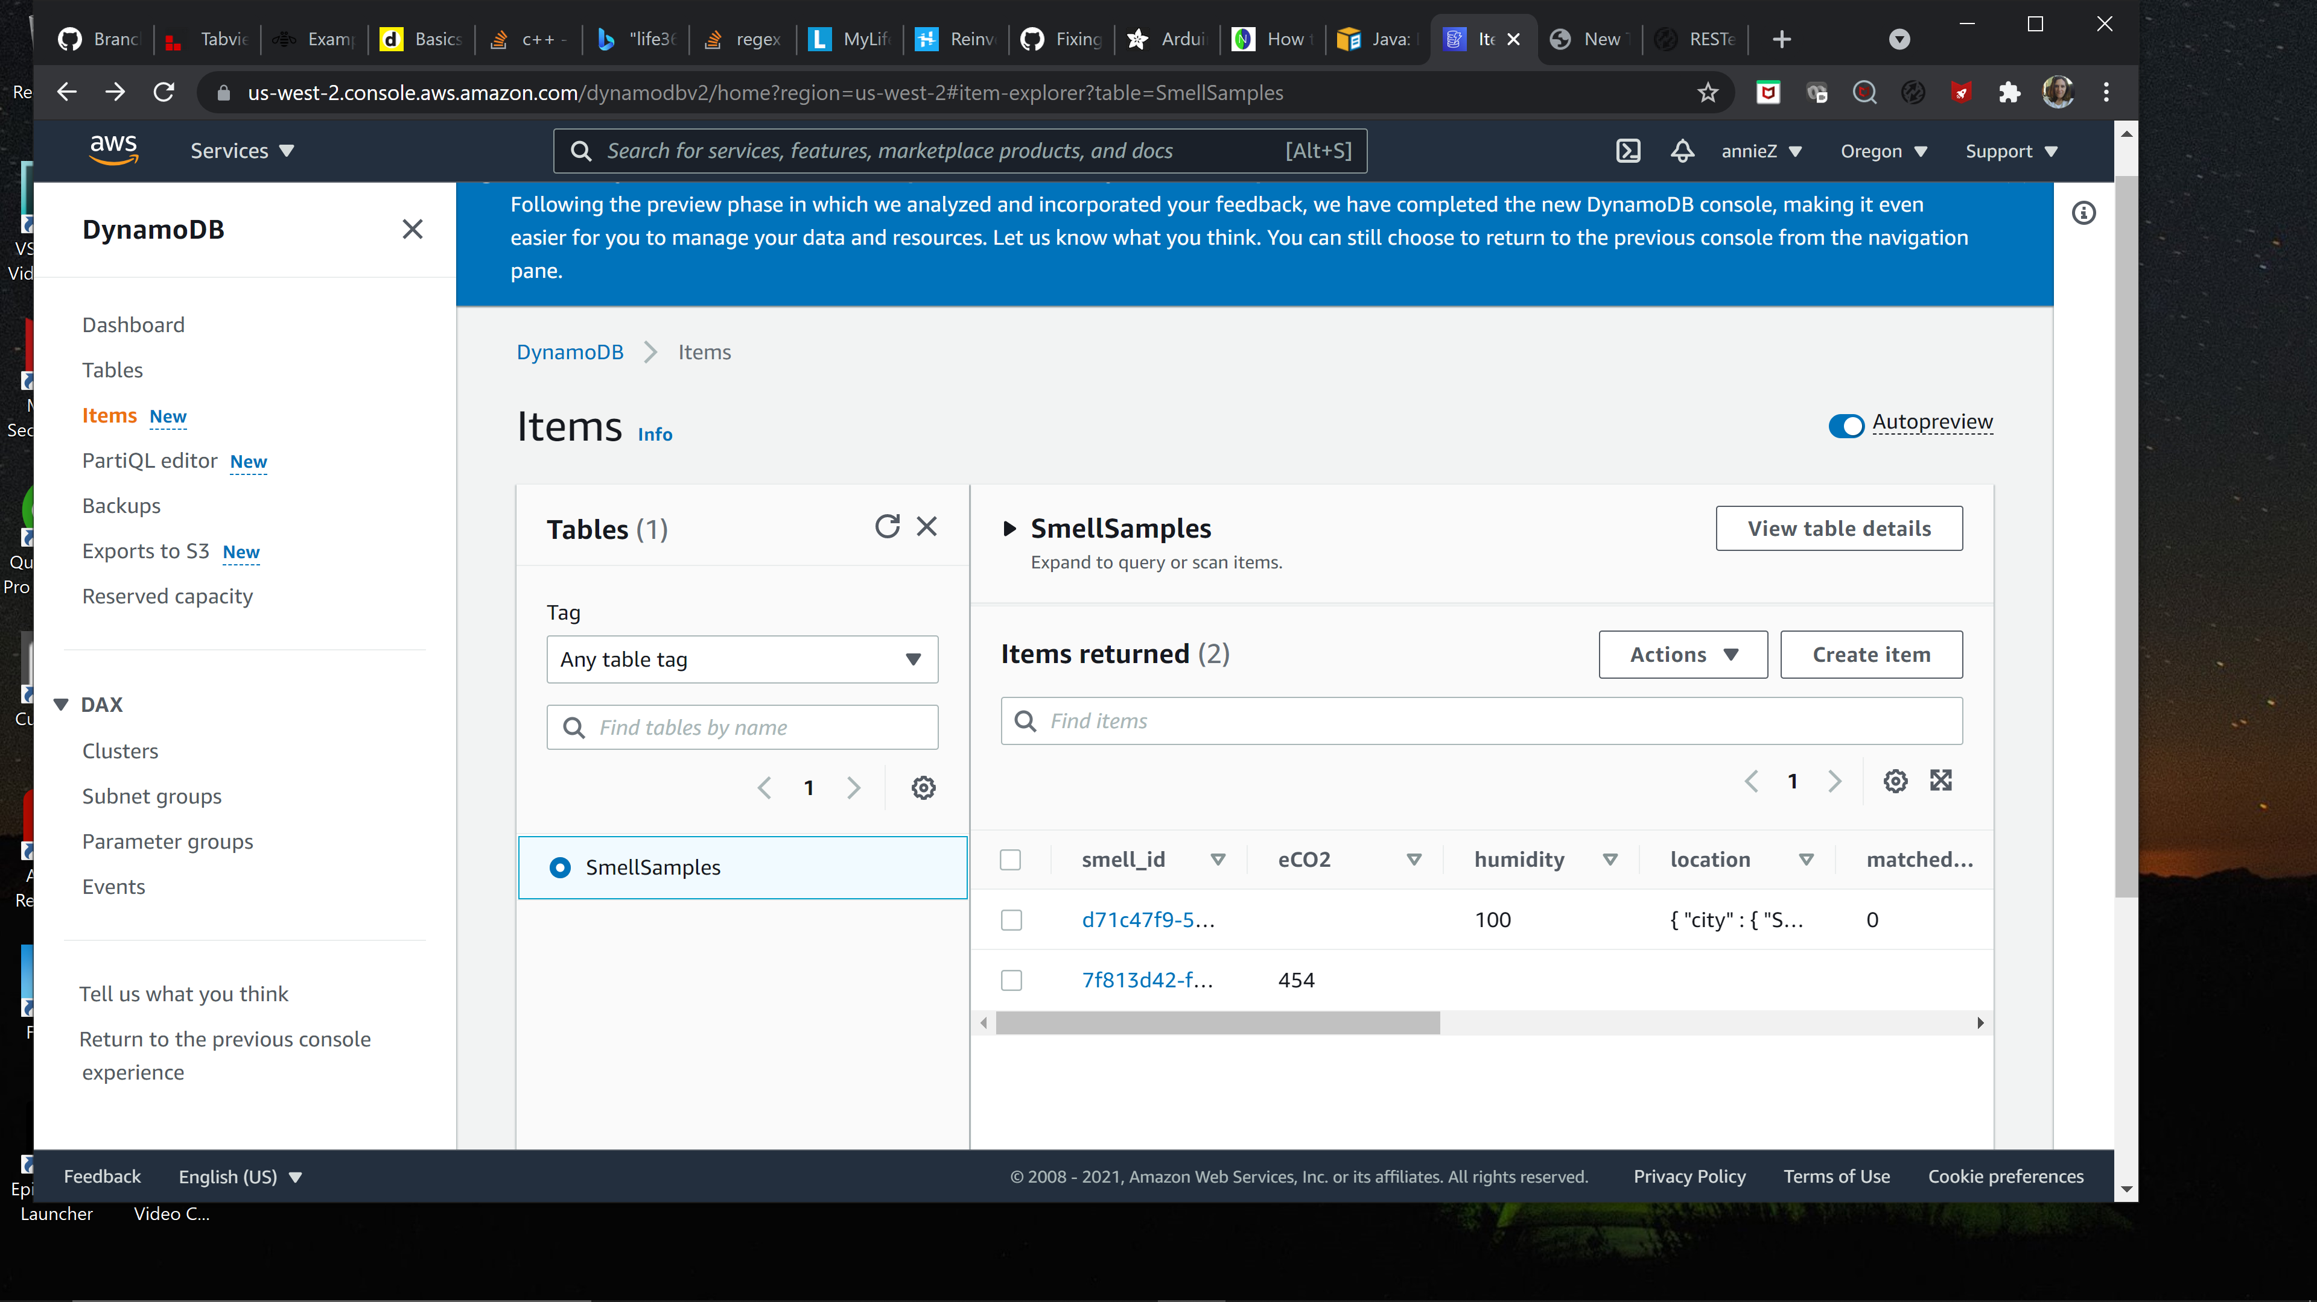

Slide 9
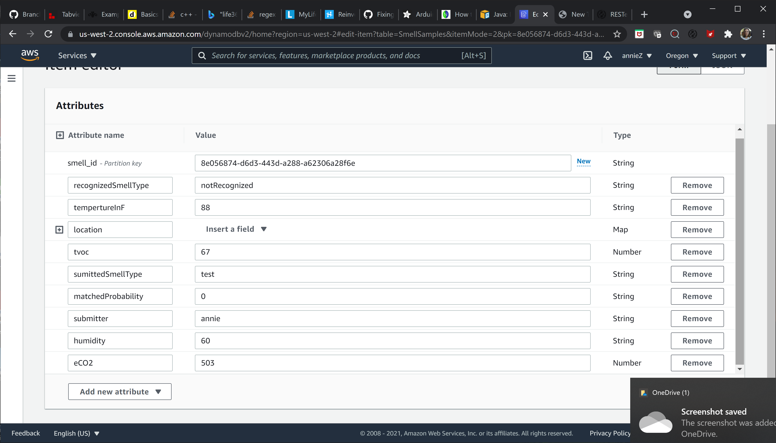

Slide 10






Health
Devices powered by Smell Collection
Science
Security
Home/Business
Education

Slide 11
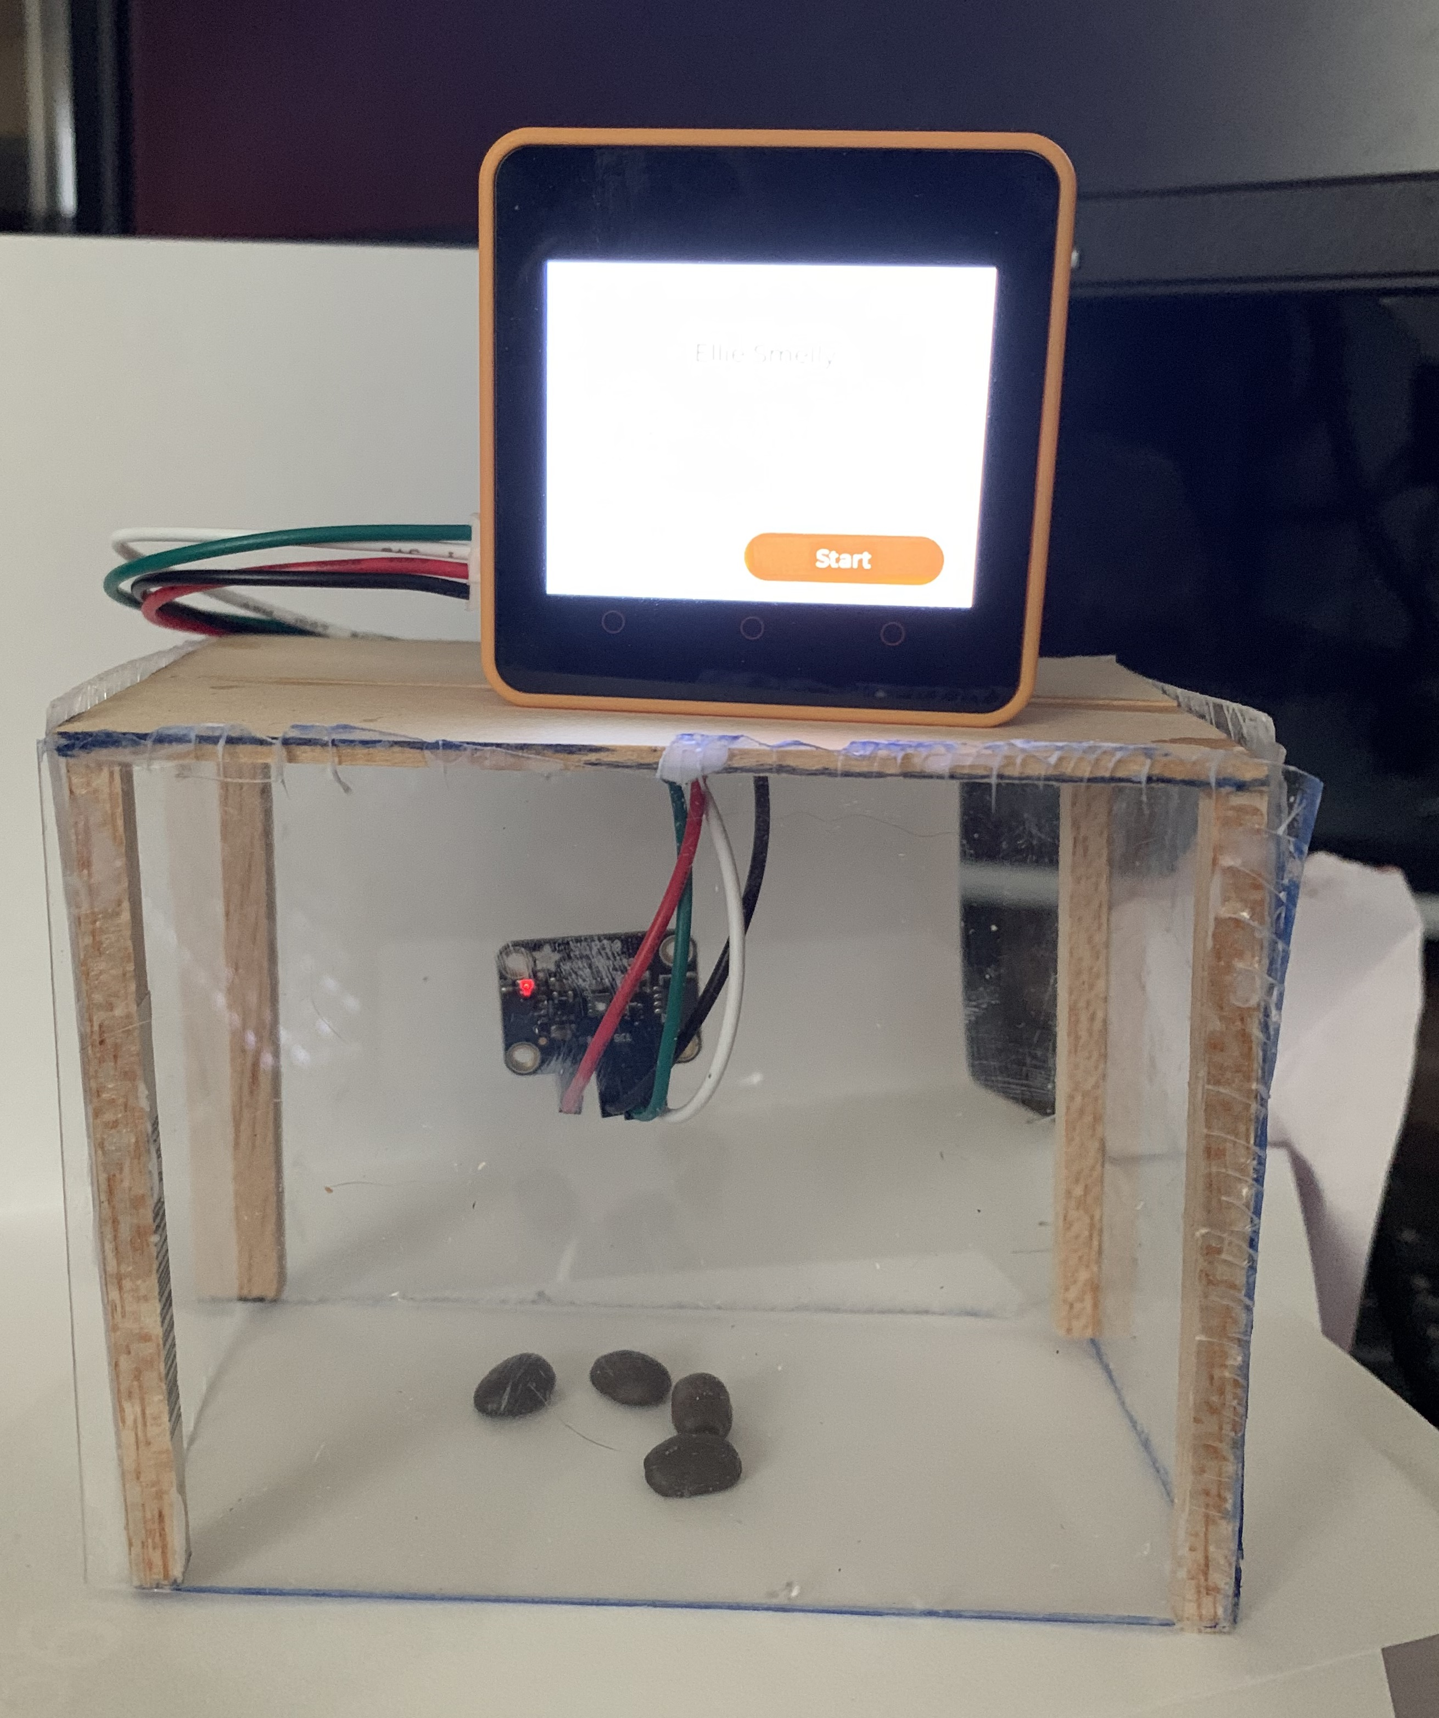


Back-end Services
Submit
User submitted data
And
Curated Smell Collection
Health
Devices powered by Smell Collection
Science
Security
Home/Business
Education

Slide 12
Back-end Services
User submitted data
And
Curated Collection

Slide 13
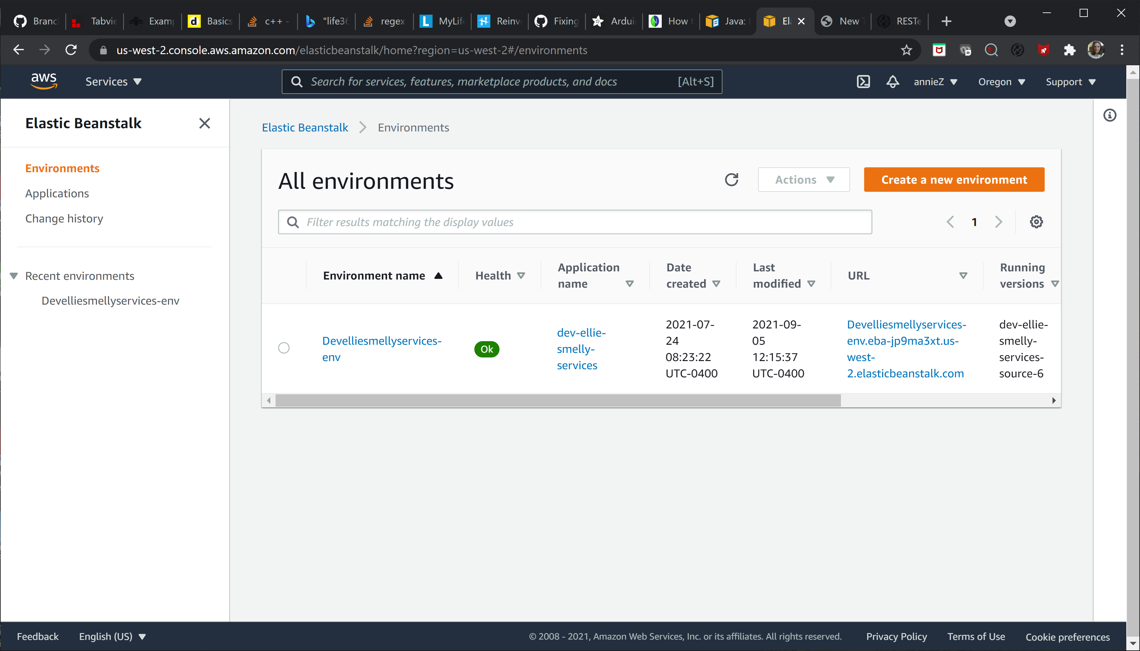

Slide 14





